Slide 1
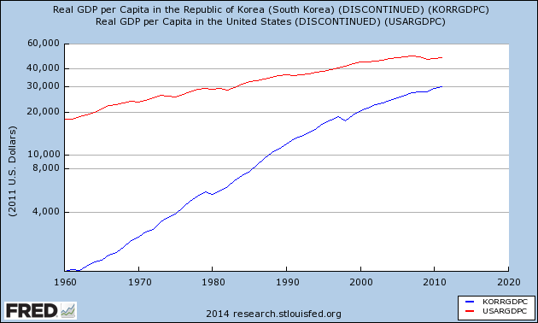
Korean “Catch-up” to US
Notes:
1

Slide 2

Economics of Global Business: GDP and AD/AS Joe Foudy
Copyright ©: Joseph Foudy 2014 (charts and illustrations copyrighted by original sources)

Slide 3
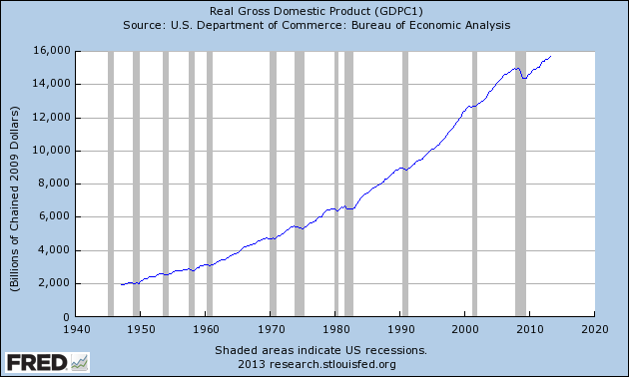
The Economy ☹

Slide 4
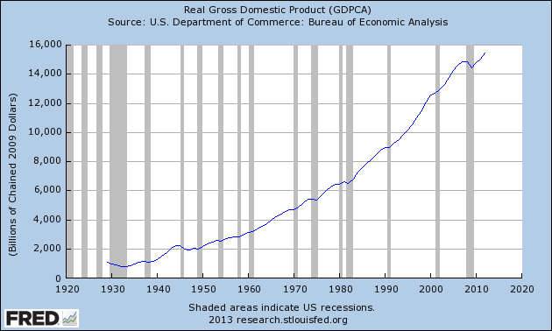
Long Term Economic Growth (Good news!)
U.S. Real Gross Domestic Product, 1929–Today

Slide 5
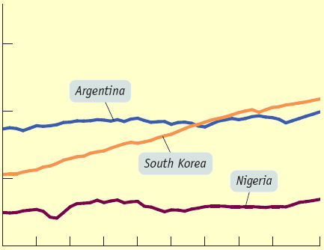
Contemporary winners and losers
Real GDP per
capita (log scale)
$100,000
10,000
1,000
1960 1970 1980 1990 2000 2007
Year
Notes:
5
Source: World Bank.

Slide 6
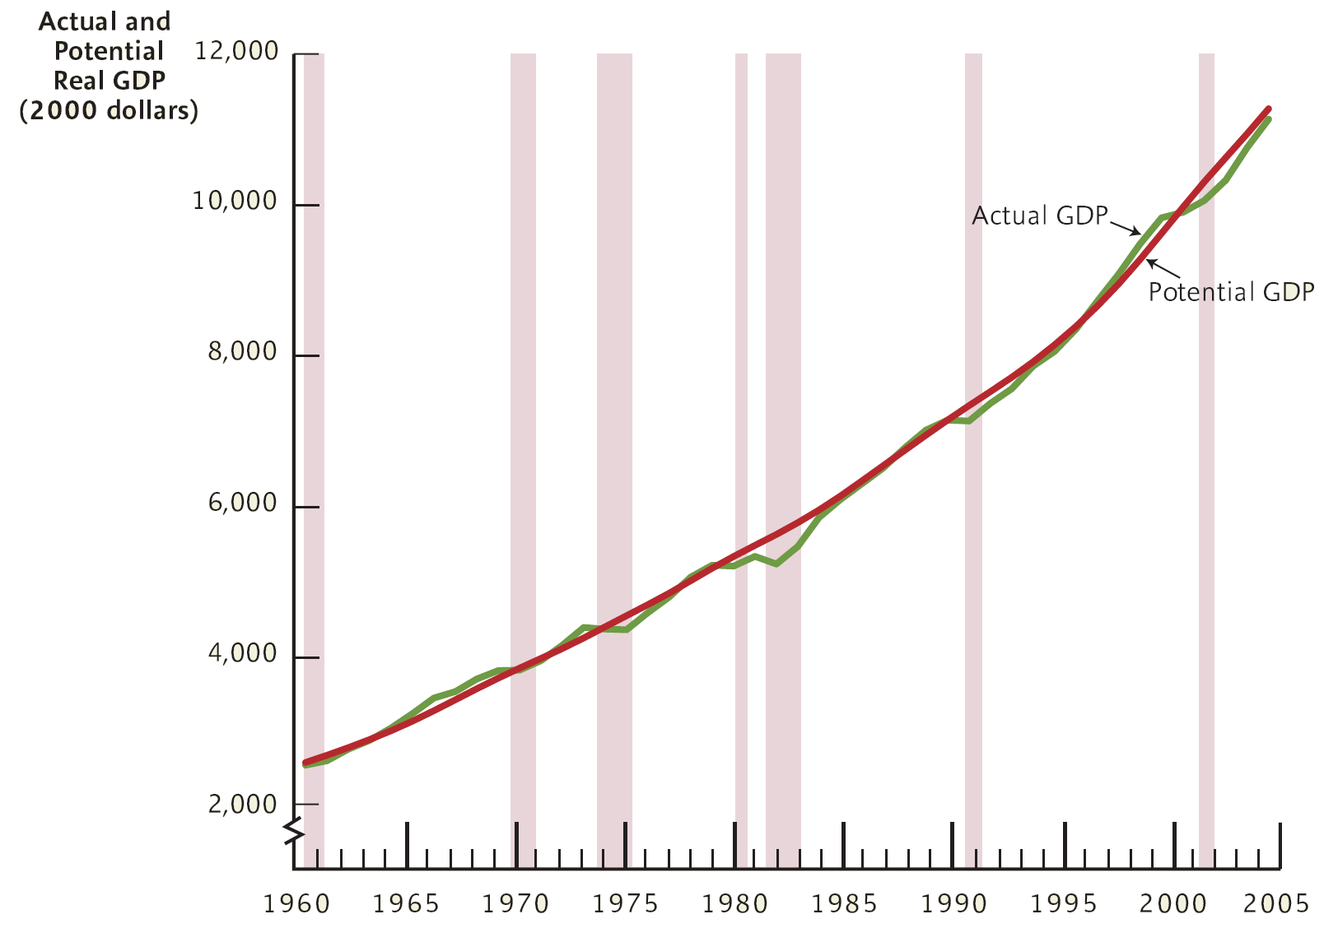
Actual And Potential Real GDP
Actual And Potential Real GDP, 1960–2005

Slide 7
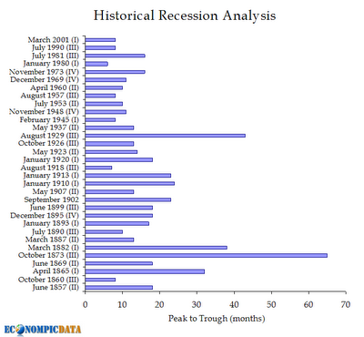
Length of Previous Recessions

Slide 8
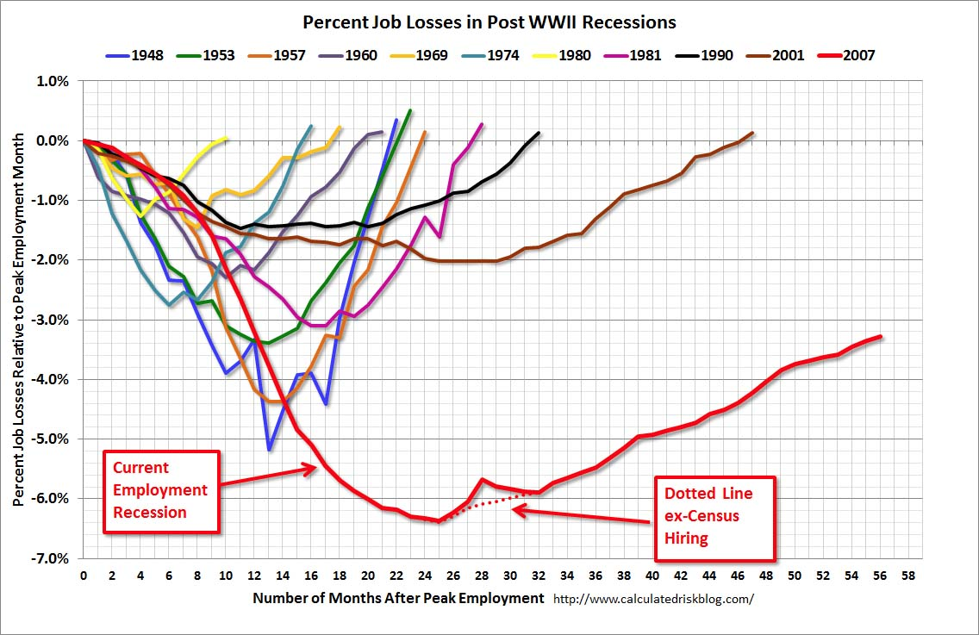
Compared to Previous Recessions

Slide 9
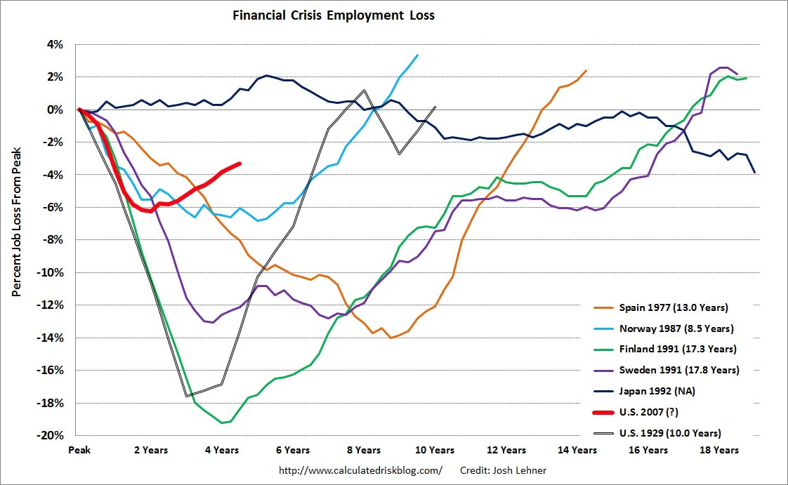
Compared to other Financial Crises

Slide 10

By Education Level – Study Hard!
Source: http://www.bls.gov/emp/ep_chart_001.htm

Slide 11
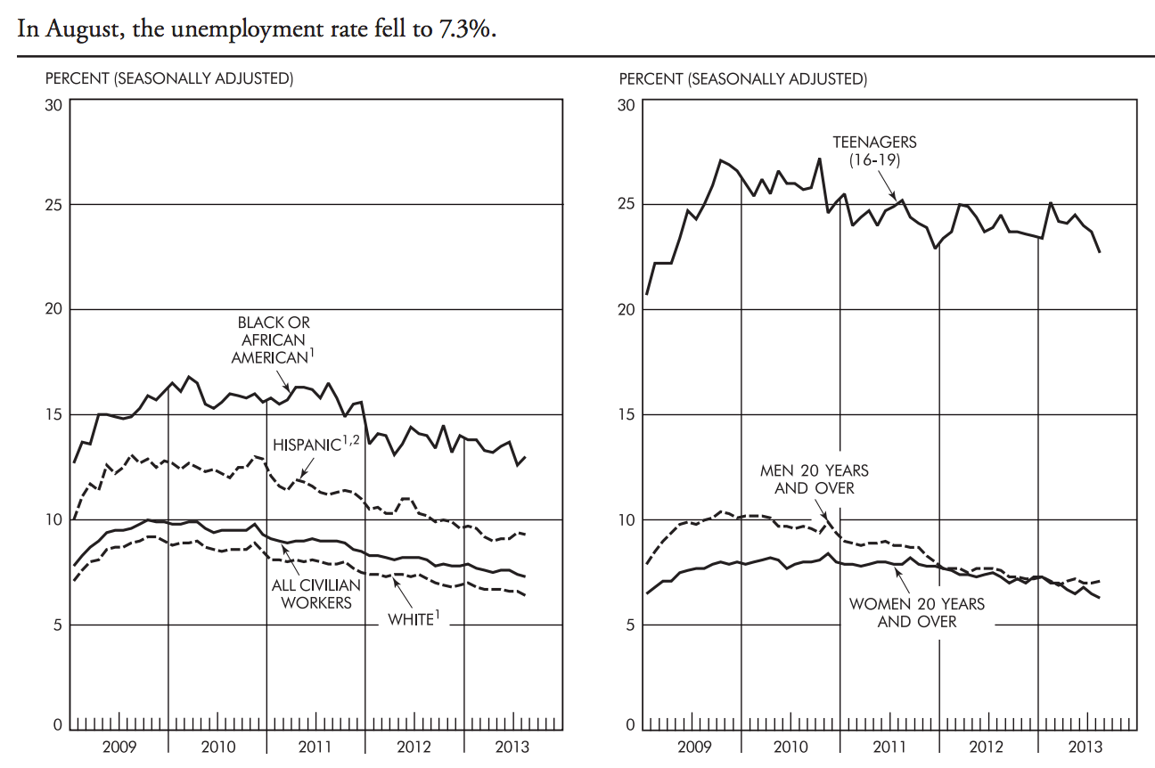
Unemployment by Race, Teenagers

Slide 12
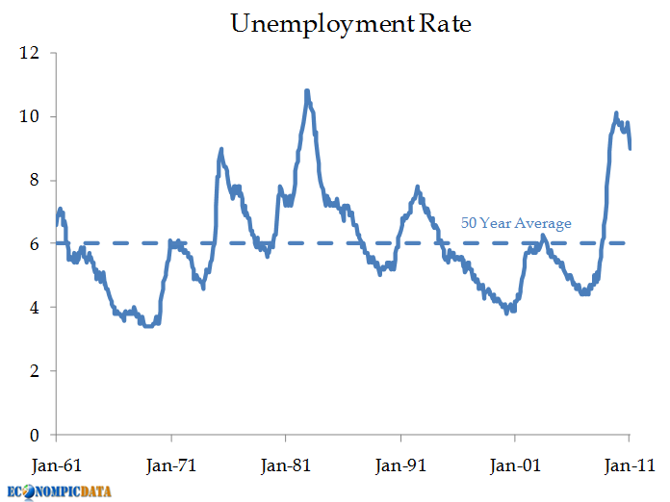
But it always recovers… U.S. Unemployment Rate, 1961–2011
Trade, technology or other factors lead to changes in the patterns of employment, but not overall employment levels!

Slide 13
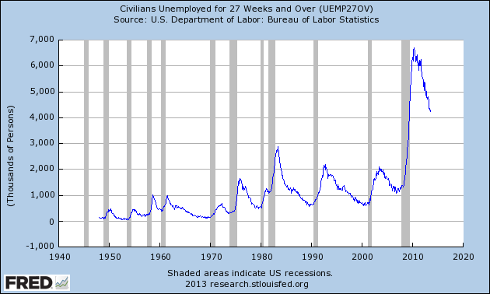
Long-term unemployed is a huge challenge that will have lasting impacts

Slide 14
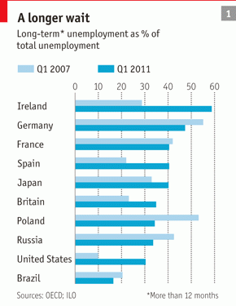
Long-term unemployed is a huge challenge that will have lasting impacts

Slide 15

Look at Youth Unemployment!

Slide 16
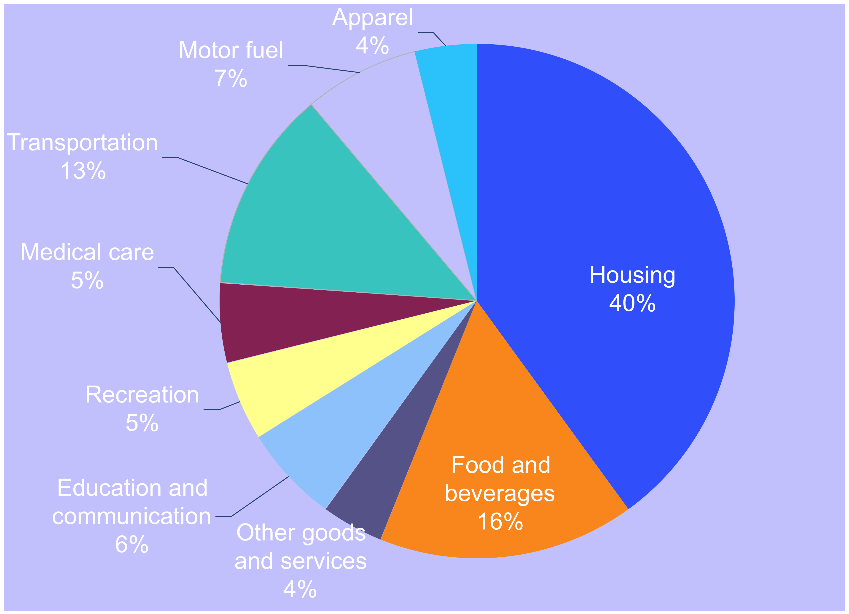
Tracking and Reporting the Price Level
Click here: http://www.nytimes.com/interactive/2008/05/03/business/20080403_SPENDING_GRAPHIC.html

Slide 17
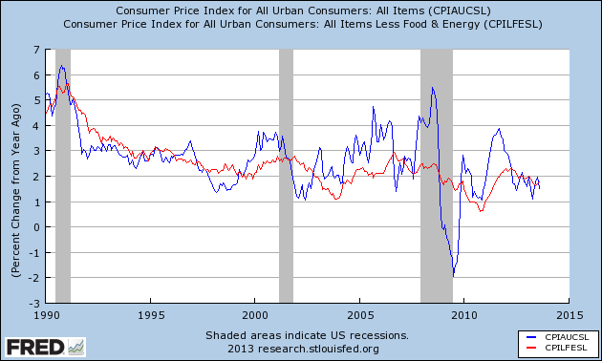
Core vs. Non-Core CPI Measures

Slide 18
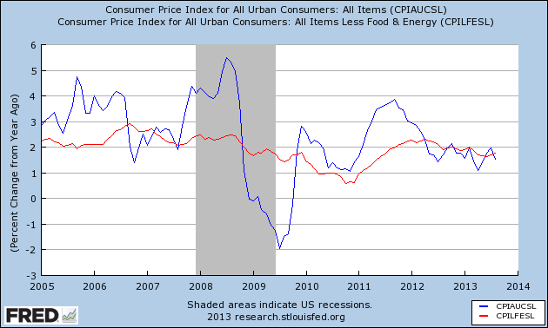
Core vs. Non-Core CPI Measures
Do we find inflation surging
In 2008 (pre crises)?
Which measure do we look at?

Slide 19
Long-Run Aggregate Supply Curve
Long-run aggregate
supply curve, LRAS
Aggregate price
level (GDP deflator,
2000 = 100)
15.0
…leaves the quantity
of aggregate output
supplied unchanged
in the long run.
A fall in the
aggregate
price level…
7.5
0
Potential
output, YP
$800
Real GDP (billions of 2000 dollars)
Notes:
Figure Caption: Figure 12-7: Long-Run Aggregate Supply Curve
The long-run aggregate supply curve shows the quantity of aggregate output supplied when all prices, including nominal wages, are flexible. It is vertical at potential output, Y_{P} , because in the long run an increase in the aggregate price level has no effect on the quantity of aggregate output supplied.
19

Slide 20
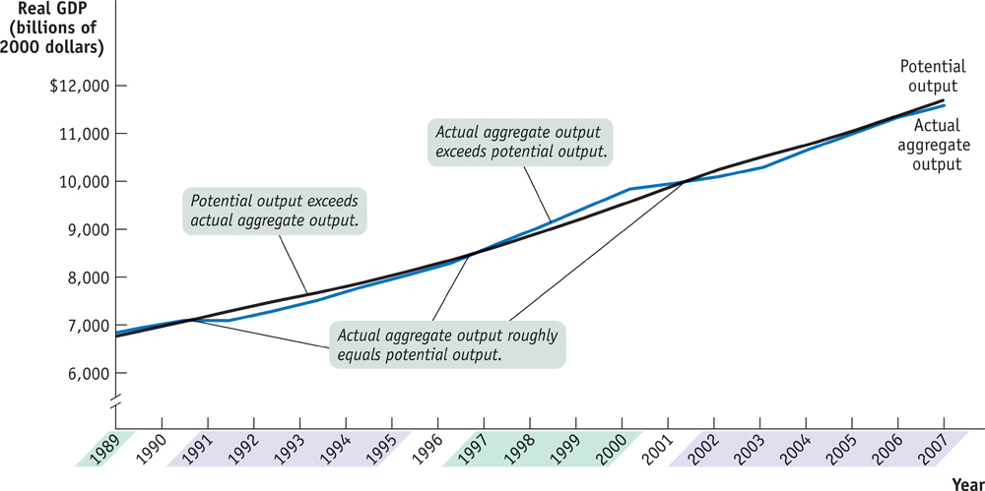
Actual and Potential Output from 1989 to 2007
Notes:
Figure Caption: Figure 12-8: Actual and Potential Output from 1989 to 2007
This figure shows the performance of actual and potential output in the United States from 1989 to 2007. The black line shows estimates of U.S. potential output, produced by the Congressional Budget Office, and the blue line shows actual aggregate output. The purple-shaded years are periods in which actual aggregate output fell below potential output, and the green-shaded years are periods in which actual aggregate output exceeded potential output. As shown, significant shortfalls occurred in the recessions of the early 1990s and after 2000. Actual aggregate output was significantly above potential output in the boom of the late 1990s.
Source: Congressional Budget Office; Bureau of Economic Analysis.
20

Slide 21
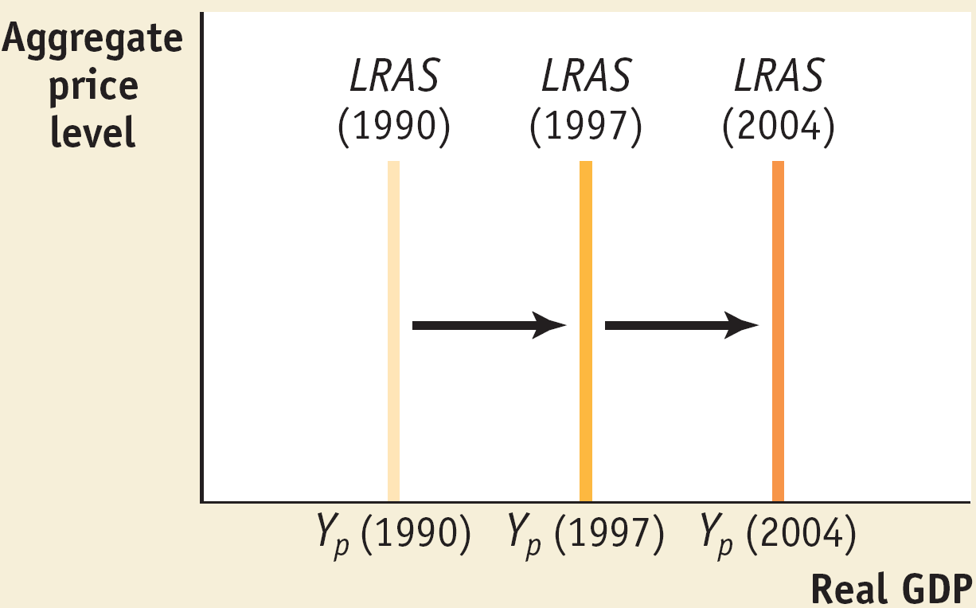
Economic Growth Shifts the LRAS Curve Output (Y) = TFP (A) x Capital Stock (K)^{α} x Hours Worked (L)^{1-α}
Notes:
Notes to the Instructor: This figure is from the earlier edition.

Slide 22
Conceptualizing Actual and Potential GDP with AD/AS Over Time
Recessionary Gap
Inflationary Gap
Notes:
Figure Caption: Figure 12-8: Actual and Potential Output from 1989 to 2007
This figure shows the performance of actual and potential output in the United States from 1989 to 2007. The black line shows estimates of U.S. potential output, produced by the Congressional Budget Office, and the blue line shows actual aggregate output. The purple-shaded years are periods in which actual aggregate output fell below potential output, and the green-shaded years are periods in which actual aggregate output exceeded potential output. As shown, significant shortfalls occurred in the recessions of the early 1990s and after 2000. Actual aggregate output was significantly above potential output in the boom of the late 1990s.
Source: Congressional Budget Office; Bureau of Economic Analysis.
22

Slide 23

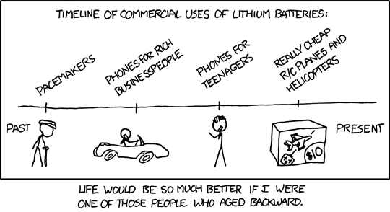
Technological Progress
Source: www.xkcd.com

Slide 24
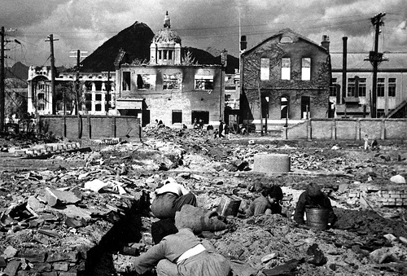
Seoul Korea in 1953

Slide 25

Seoul Korea Today

Slide 26
Growth’s Slows as States “Catch Up”
GDP
Developed
Developing States
Time
26
Notes:
26

Slide 27
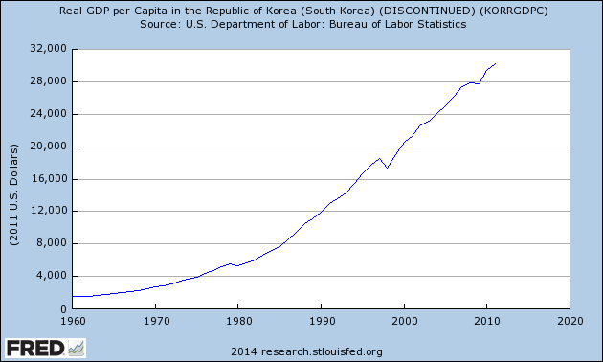
Real GDP per capita for Korea
Notes:
27

Slide 28
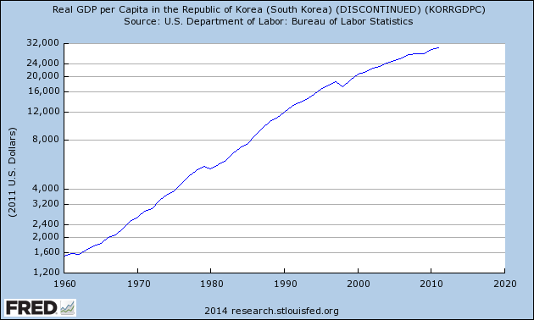
Real GDP per capita for Korea
Notes:
28

Slide 29
Growth’s Slows as States “Catch Up”
GDP
Developed
Developing States
Time
29
Notes:
29

Slide 30
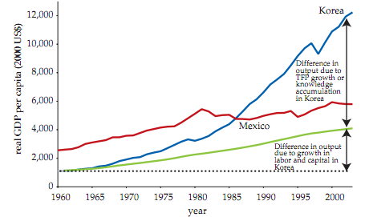
Role of TFP In Korea (blue (AKL) vs. green (KL only)
This chart (from World Bank) was actually used by some former Stern students of mine in a presentation on Korea they shared with me ☺

Slide 31
Human Capital, Education and TFP
TFP (A) is a residual term – it captures all growth that is not explained by a growth in labor hours (L) and capital spending (K)
If you do not specifically measure improvements in education and skills, greater human capital would be captured by TFP
If you measure changes in education and skills, then TFP captures all growth excluding increases capital, labor hours plus the quality of the workforce

Slide 32
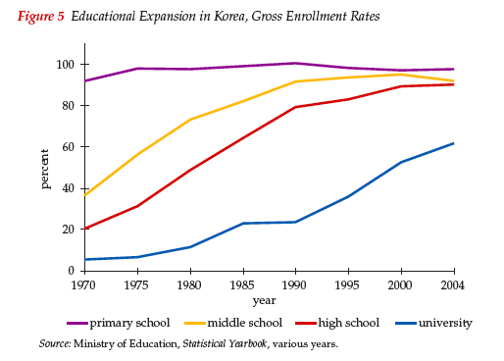
Increasing Education

Slide 33

South Korea Regularly Rules Global Test Scores
Source: http://www.guardian.co.uk/news/datablog/2010/dec/07/world-education-rankings-maths-science-reading

